Slide 1
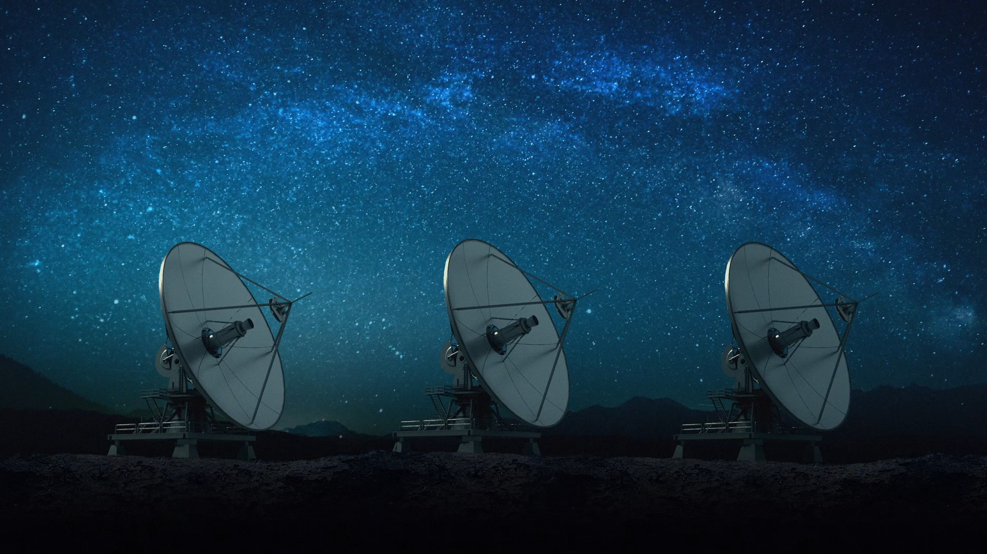
Python Web Service for space data
Autors:
Miro Rava
Oleg Lastocichin
Teacher:
Guidi Roberto

Slide 2
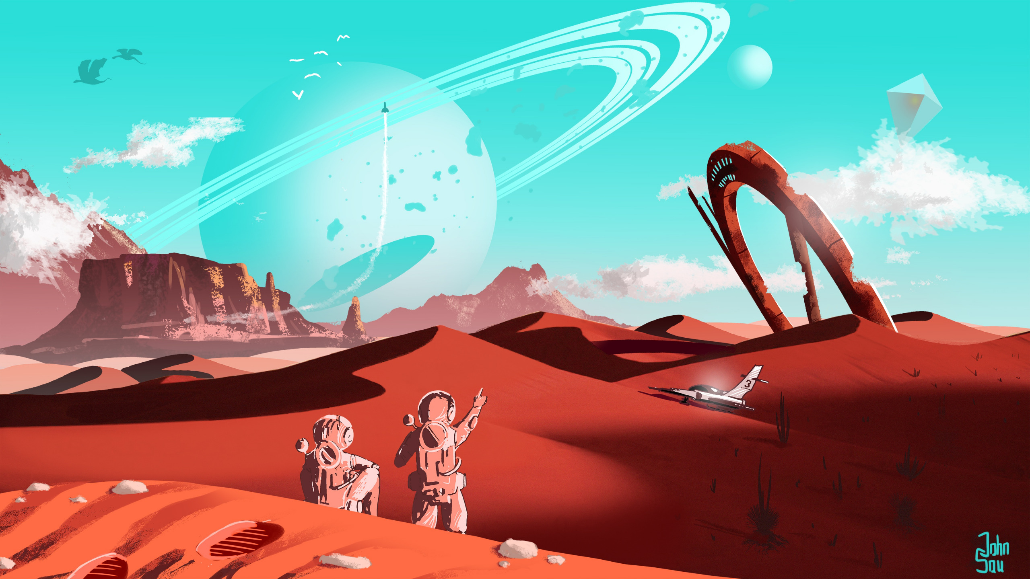
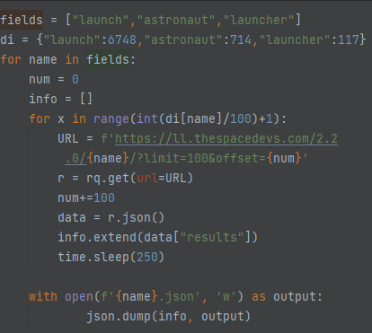
Data Exploration/Scraping
All the data was scraped from thespacedevs.com .
We created a small program that made all the requests to the api of the website.
We used additional scripts to clean the dataset and make it usable as a pandas DataFrame Object.

Slide 3

Database Management
Our Database is composed by three different Json Files Managed by a dedicated python library that uses Pandas to execute the main CRUD operations on it.
At the moment the Database File and the Web Services applications are local and not accessible from the internet, but they are independent and can be run on an external server.
The three Json Files contain information for Astronauts, Launches, and Rockets

Slide 4
Web Service
The application is made with flask and it implements all of the CRUD operations
Each endpoint refers to an item into the DataFrame.
The Web Service application uses custom created functions to interact with the DBMS and query the Database
From the Web Service, Json formatted strings are retrieved and used then the client Library

Slide 5
Client Library
The Client Library uses classes to store information and entries to and from the web service.
Each class object is then converted into a json formatted string that is sent to the web service.
The Client Library implements operations and functions that you can apply to the retrieved objects.
The result of these operations will be used then into the Demo Application.

Slide 6
Demo Application
The Demo Application is written in python and has a gui by which you can execute all the CRUD operations and other simple statistics
The GUI can display Plots related to the data.

Slide 7
Unit Testing
Through the use of Unit Testing we will check any error and problem in all the parts of the project.
Coming Soon! ☺

Slide 8
Conclusions
Q&A
Progression
Thank you for listening

